Slide 1
Arduino Data Collection
Nick Falco

Slide 2
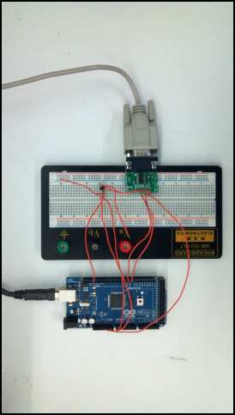

Slide 3
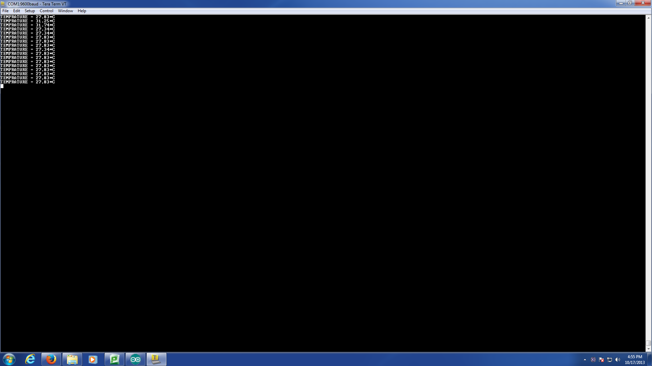
Temperatures Received By Serial Port

